Slide 1


FORENSICS
3 - Windows, Memory
!! nos4a2
@sluzypt
AFSC19.EXE @afsc19

Slide 2
ROAD
MAP
1. Foundations
2. Disks, registries, network
3. Windows, memory
4. ???

Slide 3
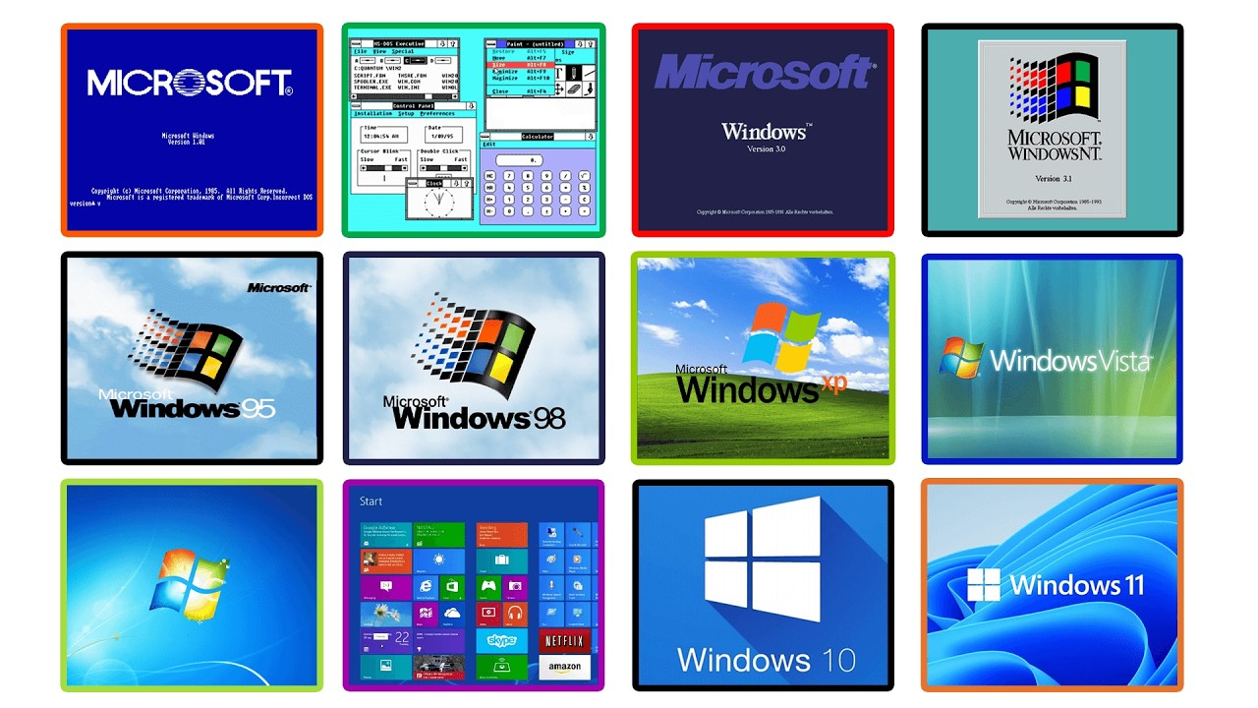
Windows

Slide 4
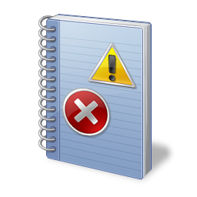
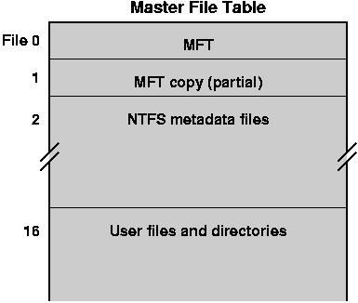


Windows - Stores (almost) everything!
Event Logs
MFT
…
Registry
Prefetch

Slide 5
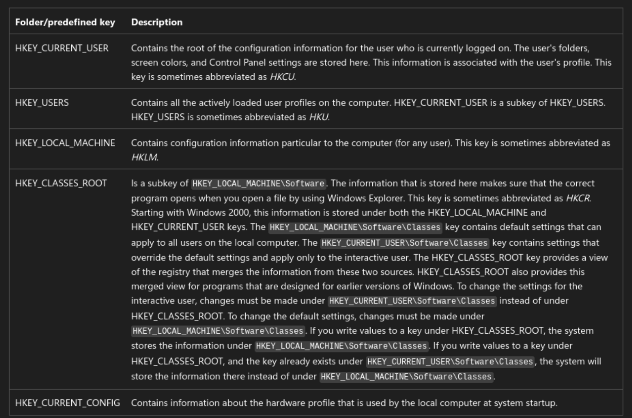
Windows Registry - Locations
C:\Users\<user>\NTUSER.dat
C:\Windows\System32\config

Slide 6
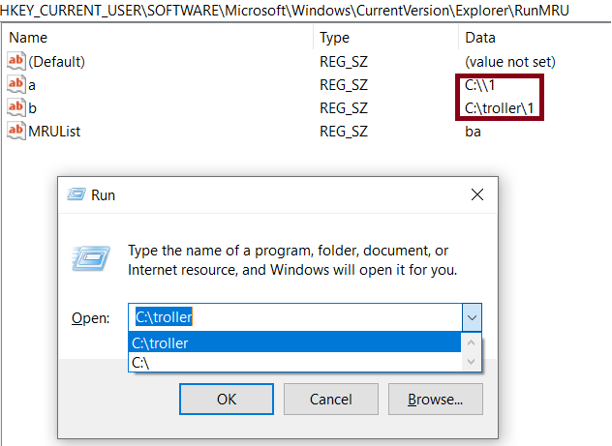
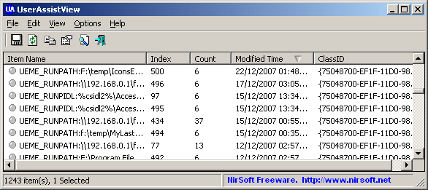
Windows Registry - Execution evidence
UserAssist
HKCU\Software\Microsoft\Windows\CurrentVersion\Explorer\UserAssist
RunMRU
HKCU\Software\Microsoft\Windows\CurrentVersion\Explorer\RunMRU

Slide 7
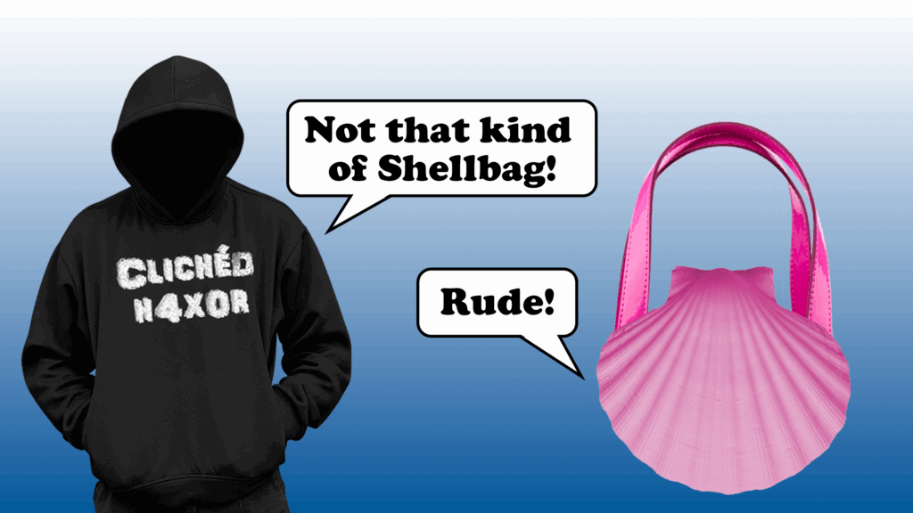
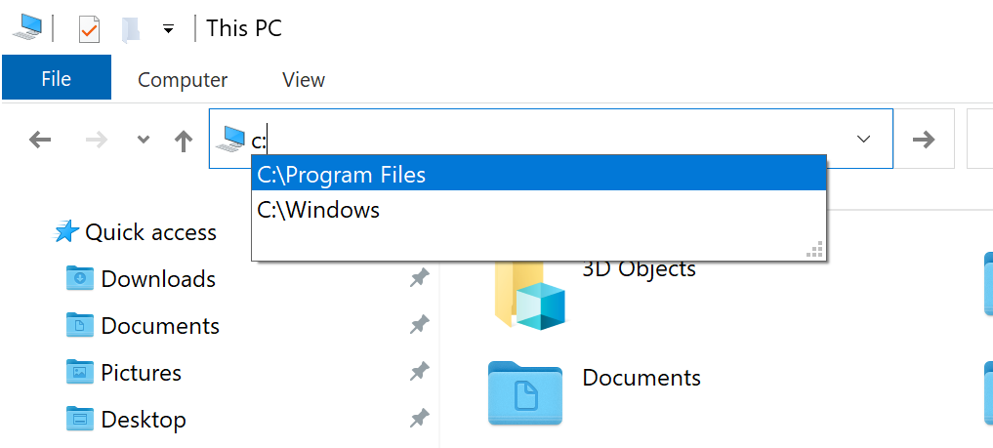
Windows Registry - User activity
Shellbags
HKCU\Software\Microsoft\Windows\Shell\Bags
Typed paths (in Windows Explorer)
HKCU\Software\Microsoft\Windows\CurrentVersion\Explorer\TypedPaths

Slide 8
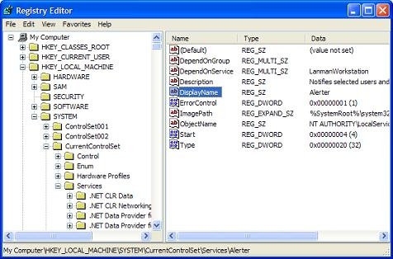
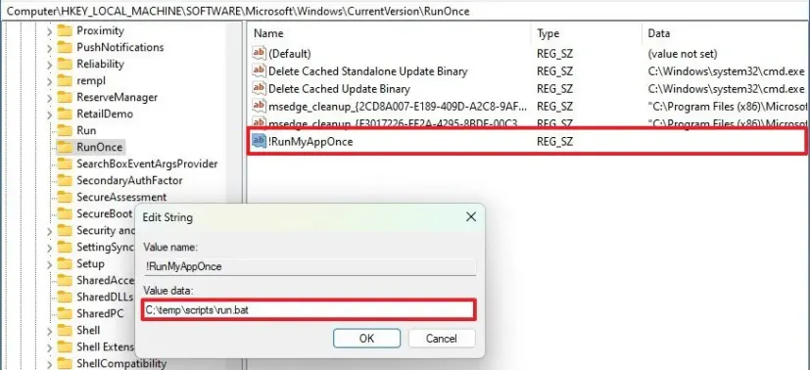
Windows Registry - Startup programs
Run/RunOnce
HKLM\Software\Microsoft\Windows\CurrentVersion\Run[Once]
Services
HKLM\SYSTEM\CurrentControlSet\Services

Slide 9
Windows Registry - Other informations
USB & External Device History (USBSTOR)
Network Configuration & History (NetworkList)
Mounted Devices (MountedDevices)
Windows Time Zone Information
Audit Policy Settings
System Information & OS Versioning
Computer Name & Domain Membership
Background Activity Moderator (BAM/DAM)
And so on ….

Slide 10
Windows Registry - Other informations

Slide 11
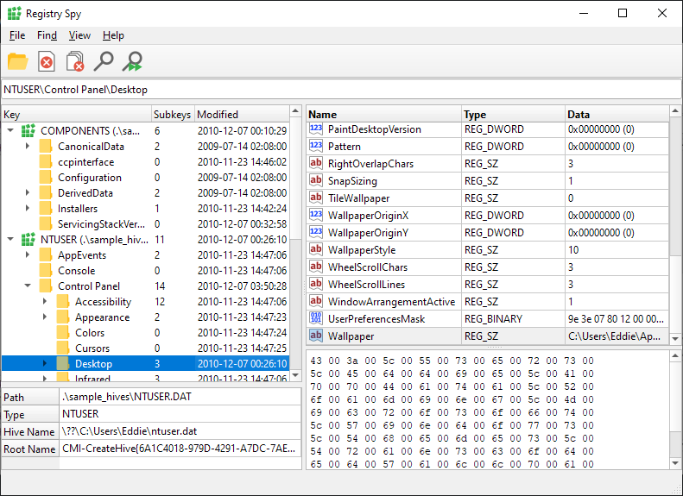
Windows Registry - Tools
Registry Explorer (Windows - Eric Zimmerman’s Tools)
Registry-Spy

Slide 12
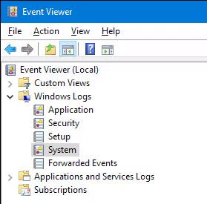
Windows Event Logs
Security
Authentication & Logon Activity
Account Management
Audit Policy & Log Tampering
Privilege Escalation
Application
Software Crashes/Faults
Software Installs
Database Engine (ESENT) Events
App-Specific Audits

Slide 13
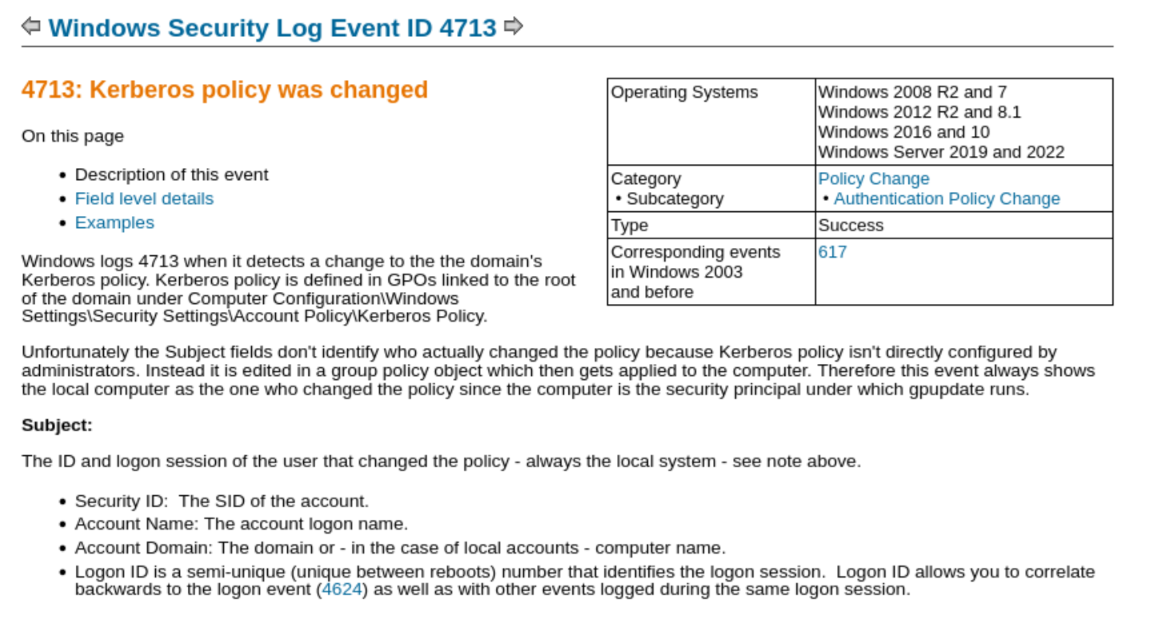
Windows Event Logs
System
Service Installation
System Health
Time Changes
Network/IP Events
Check what event IDs you’re
looking for, using a list.
Tools:
Windows Event Viewer itself
omerbenamram/evtx
VS Code EVTX extension
Python-evtx
Lookup for details!

Slide 14
Windows - Tools for the rest
Eric Zimmerman’s tools
NirSoft’s tools
San’s tool curation
MFT
(Alternate data streams)
…
Prefetch
(Prefetch of files ran)

Slide 15
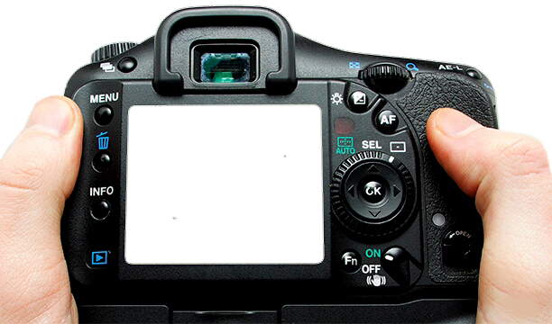
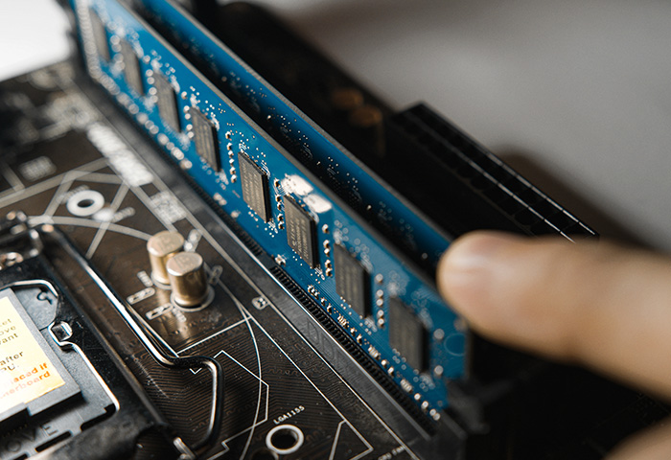
Memory Dumps

Slide 16
Memory Dumps - Information to extract
Running processes
Command history
Files
Loaded kernel modules
Network information
…

Slide 17
Memory Dumps - Tools
Volatility 2 (docker run)
Volatility 3
MemProcFS

Slide 18
Why 2 versions of volatility?
Updated to Python3, lost some modules
imageinfo
connections, connscan, sockets, sockscan
deskscan, sessions, atomscan, userhandles
apihooks
Iehistory
screenshot
notepad
clipboard
cmdscan, consoles

Slide 19
Volatility - symbols
Finding banners
❯ python3 volatility3/vol.py -f memory.elf banners
Offset Banner
0x156000e0 Linux version 6.12.73+deb13-amd64 (debian-kernel@lists.debian.org) (x86_64-linux-gnu-gcc-14 (Debian 14.2.0-19) 14.2.0, GNU ld (GNU Binutils for Debian) 2.44) # SMP PREEMPT_DYNAMIC Debian 6.12.73-1 (2026-02-17)
Finding the symbols
Abyss-W4tcher/volatility3-symbols
Extracting them
Download the debug-symbol vmlinux
Extract using dwarf2json
❯ dwarf2json linux --elf ./debian-debug/boot/vmlinux-4.4.0-137-generic > output.json

Slide 20
Dynamic Analysis
Remote
Any.run
tria.ge
Joe Sandbox
Cuckoo Sandbox
Local (Inside a VM)
API Monitor
Windows SysInternals

Slide 21
Other Tools
mesquidar/ForensicsTools
cugu/awesome-forensics

